Slide 1

Object-Oriented Software Analysis & Design (COMP-3220) Lecture 9 Iterator and Composite Patterns
School of Computer Science
Faculty of Science
University of Windsor
Dr. Saeed Samet

Slide 2
Iterator Pattern

Slide 3
Intent & Motivation
Intent
It provides a way to access elements of a collection sequentially without exposing the underlying representation of the collection.
It separates:
Traversal logic
Collection structure
This allows collections and traversal algorithms to evolve independently.
Motivation
Suppose we have different collections:
Array
List
Tree
Stack
Queue
Each collection stores data differently. Without the Iterator Pattern:
Clients must know internal structures.
Traversal logic becomes duplicated.
Collection implementations become tightly coupled to clients.
The Iterator Pattern encapsulates traversal behavior into iterator objects.

Slide 4
Problems It Solves
Hides internal collection representation.
Simplifies collection traversal.
Supports multiple traversal strategies.
Reduces coupling.
Promotes Single Responsibility Principle.

Slide 5
Real-Life Analogy
A TV remote allows you to browse TV channels one by one.
You do not need to know:
How channels are stored internally
How the television system organizes data
The remote simply provides:
next()
previous()
Similarly, an iterator provides controlled sequential access to collection elements.

Slide 6
Iterator Pattern Structure
Main Participants
Iterator
Defines traversal operations.
Concrete Iterator
Implements traversal logic.
Aggregate (Collection)
Defines method for creating iterators.
Concrete Aggregate
Stores objects and creates iterator instances.
Client
Uses iterator to traverse elements.

Slide 7
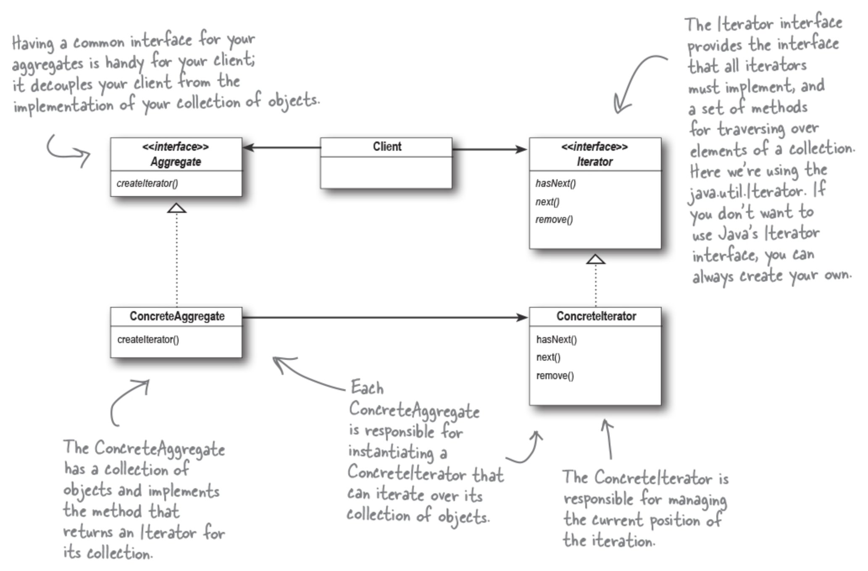
Iterator Pattern – Class Diagram

Slide 8
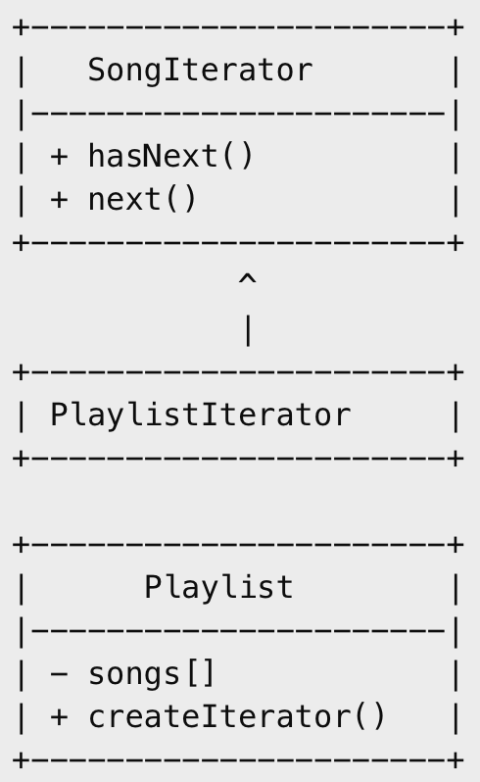
Example: Music Playlist
Suppose we have a playlist application.
Users want to browse songs sequentially.
The playlist internally stores songs in an
array, but clients should not directly access
the array.
The Iterator Pattern provides a clean traversal mechanism.

Slide 9
How It Works
Client requests iterator from Playlist
Playlist creates PlaylistIterator
Client repeatedly calls hasNext()
Client calls next() to get songs
Iterator controls traversal internally

Slide 10
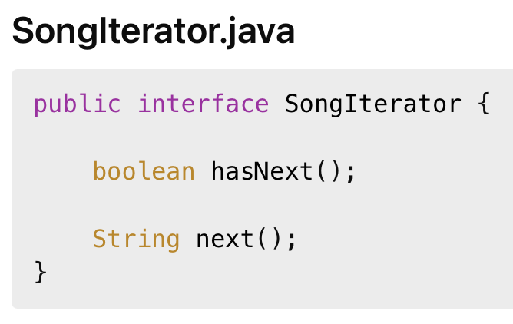
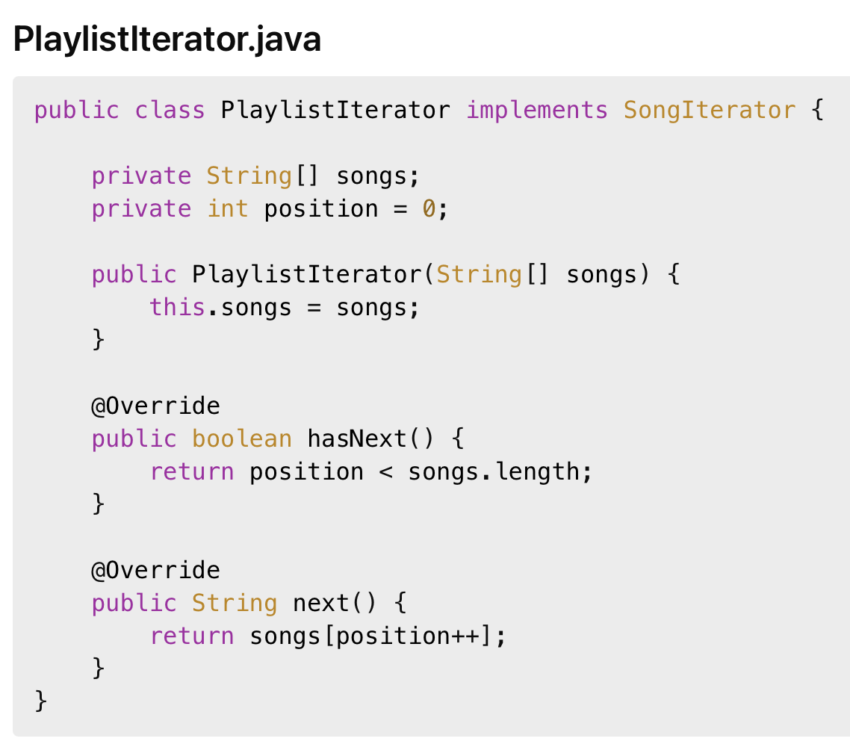
Java Code

Slide 11
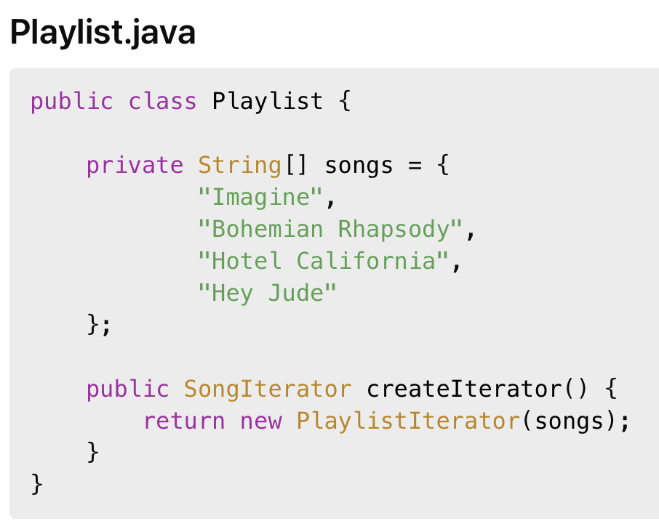
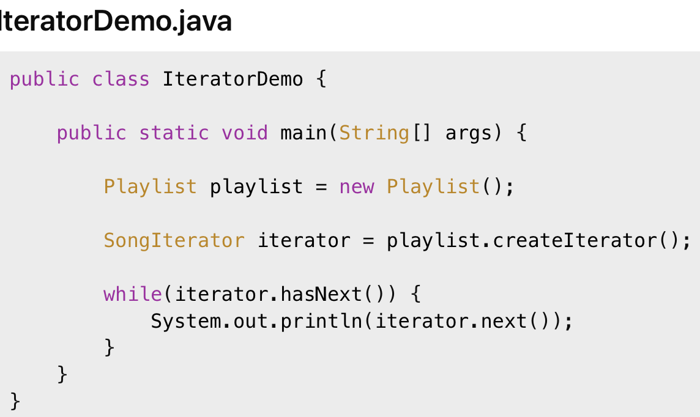
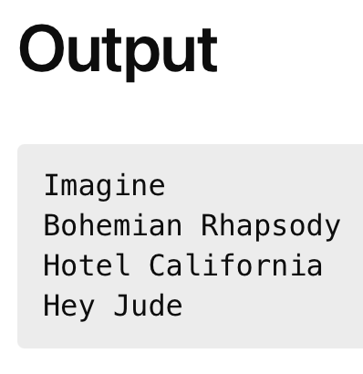
Java Code

Slide 12
Advantages & Disadvantages
Advantages of Iterator Pattern
Encapsulates traversal logic.
Hides collection implementation.
Supports multiple traversals.
Simplifies client code.
Promotes clean architecture.
Disadvantages
Adds additional classes.
Can be unnecessary for very simple collections.

Slide 13
Use Iterator Pattern when
You need sequential access to collection elements.
Internal collection structure should remain hidden.
Multiple traversal methods may exist.
You want cleaner traversal logic.

Slide 14
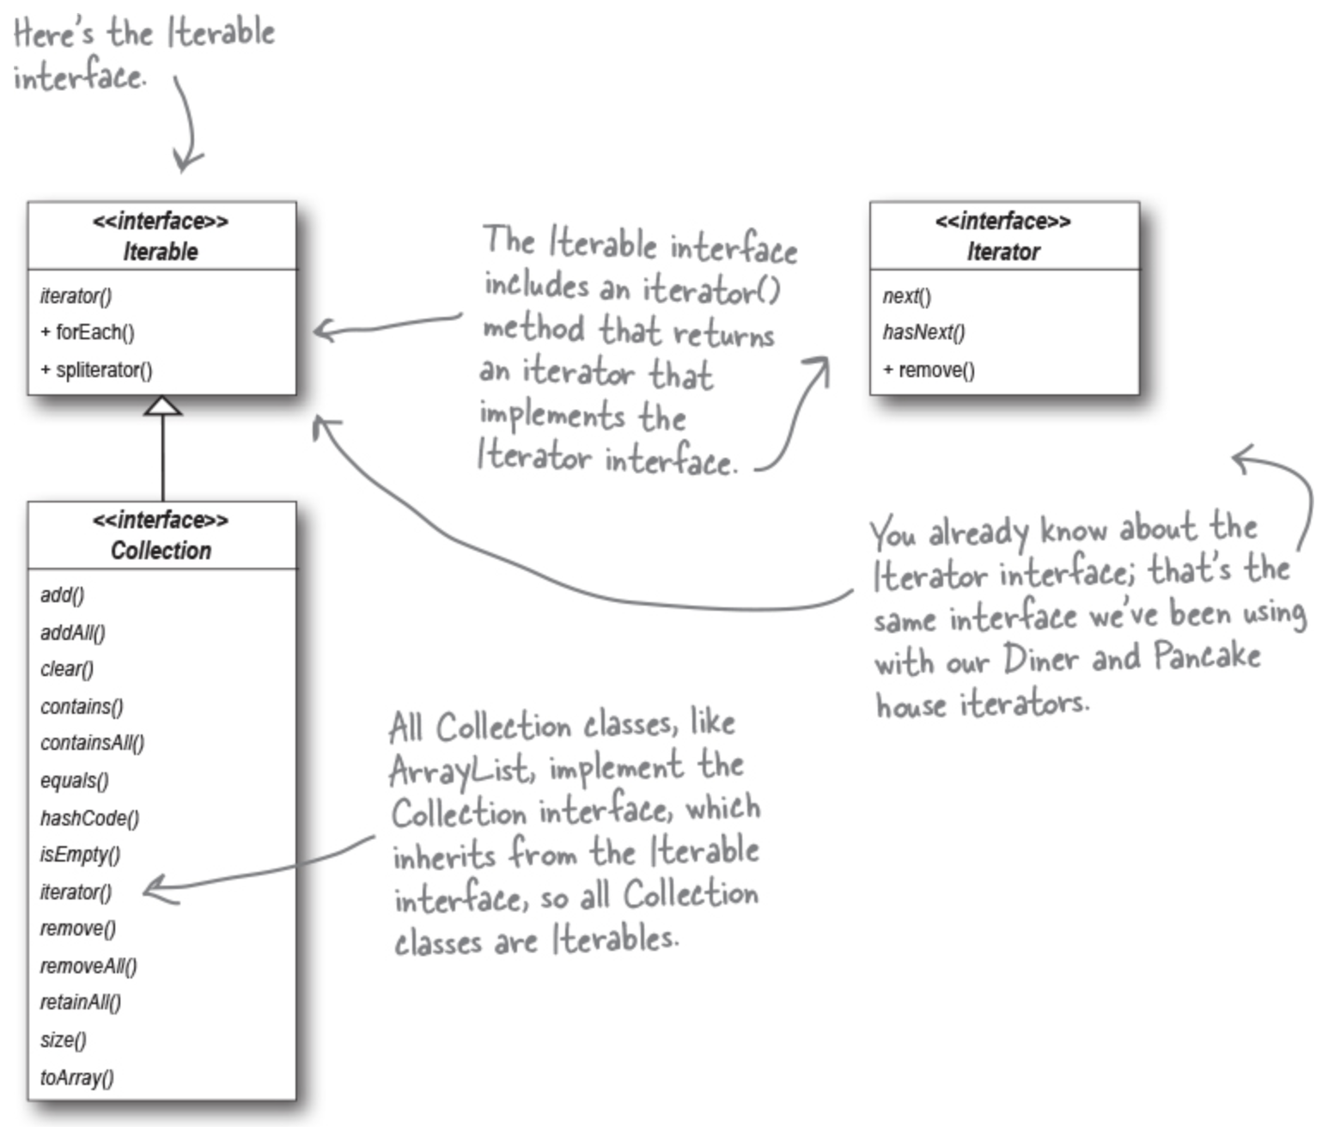
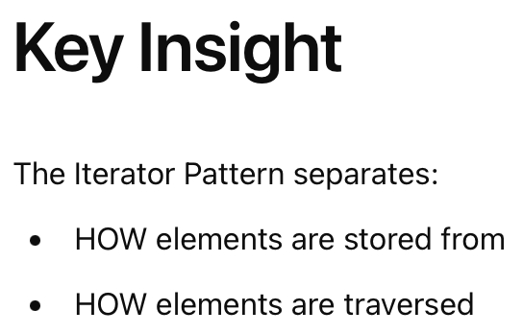
Java Collections Framework

Slide 15
Composite Pattern

Slide 16
Intent
The Composite Pattern composes objects into tree structures to represent part-whole hierarchies.
It allows clients to treat:
Individual objects
Groups of objects
uniformly.

Slide 17
Motivation
Many systems contain hierarchical structures:
File systems
Organization charts
GUI components
XML/HTML documents
Clients often need to treat:
Single elements
Collections of elements
in the same way.
Without Composite Pattern:
Client code becomes complex.
Many special-case conditions appear.
Tree operations become difficult.
Composite provides a unified abstraction.

Slide 18
Problems It Solves
Simplifies tree structures.
Treats individual and composite objects uniformly.
Reduces client complexity.
Supports recursive structures.
Simplifies hierarchical processing.

Slide 19
Real-Life Analogy
A company organizational structure.
An employee may be:
An individual worker OR
A manager supervising employees
Both employees and managers are treated as “employees”.
Managers can contain other employees recursively.

Slide 20
Composite Pattern Structure
Main Participants
Component
Common interface for all objects.
Leaf
Represents individual objects.
Composite
Contains child components.
Client
Works uniformly with all components

Slide 21
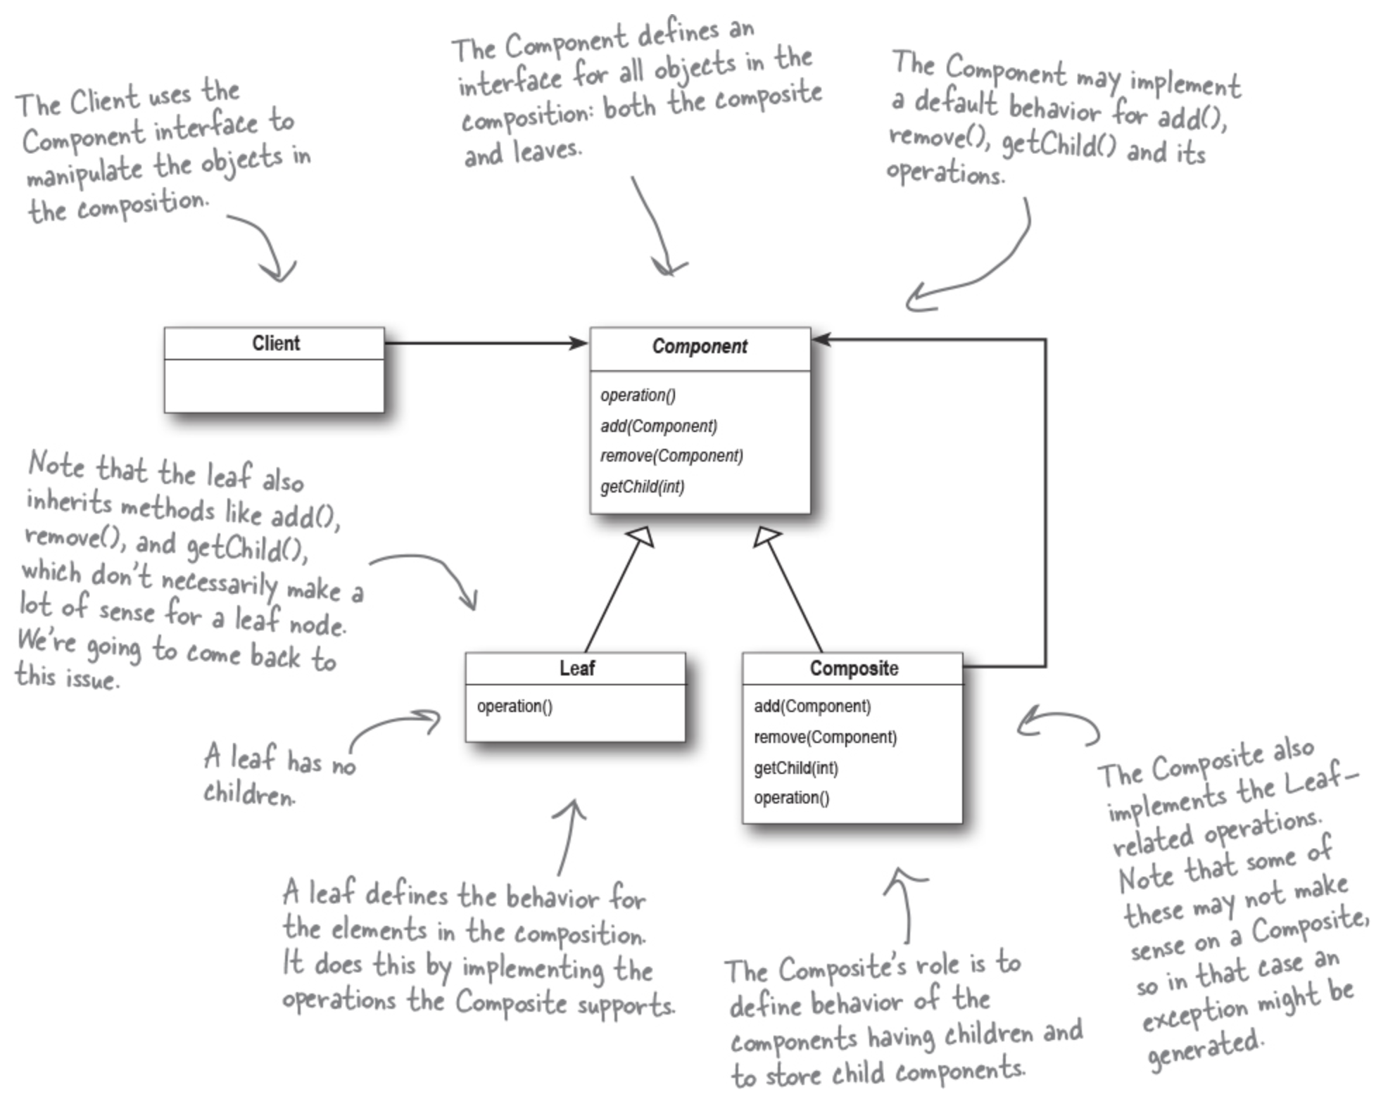
Composite Pattern – Class Diagram

Slide 22
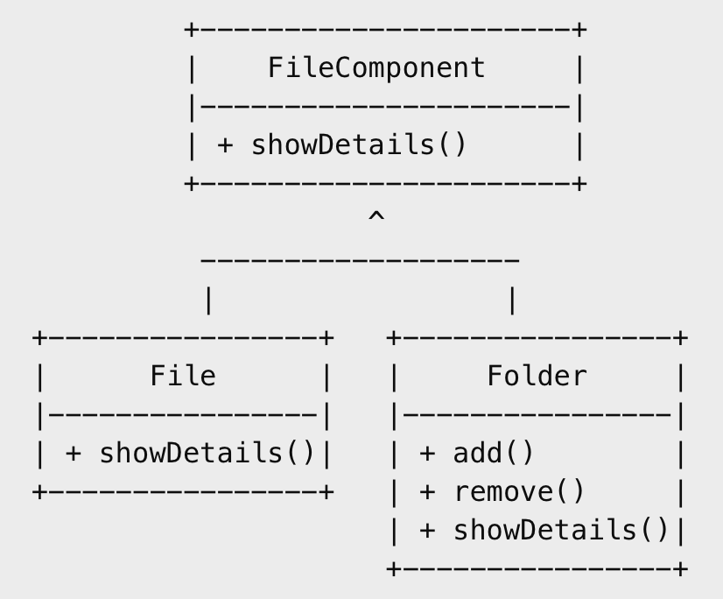
Example: File System
We model:
Files
Folders
Folders may contain:
Files
Other folders
Clients should treat both uniformly.

Slide 23
How It Works
Client creates files and folders
Folder stores FileComponent objects
Folder may contain files or other folders
Client calls showDetails()
Composite recursively delegates calls to children

Slide 24
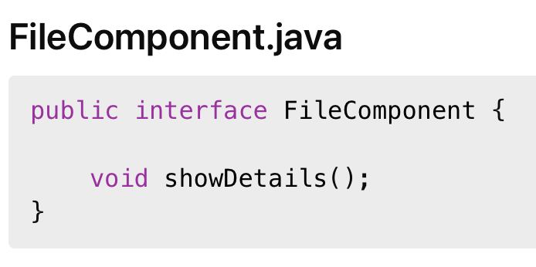
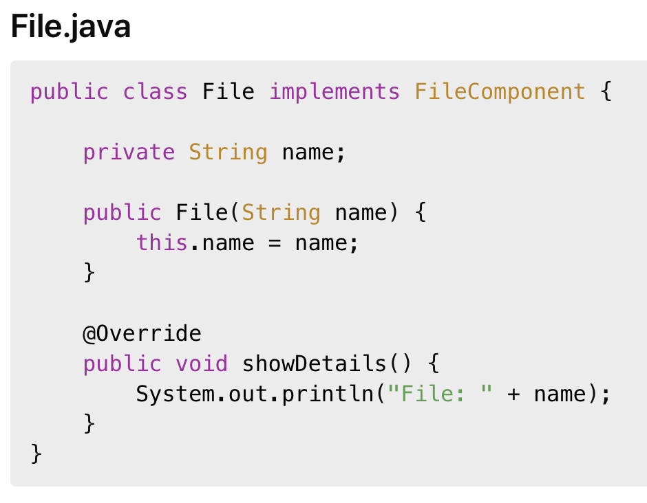
Java Code

Slide 25
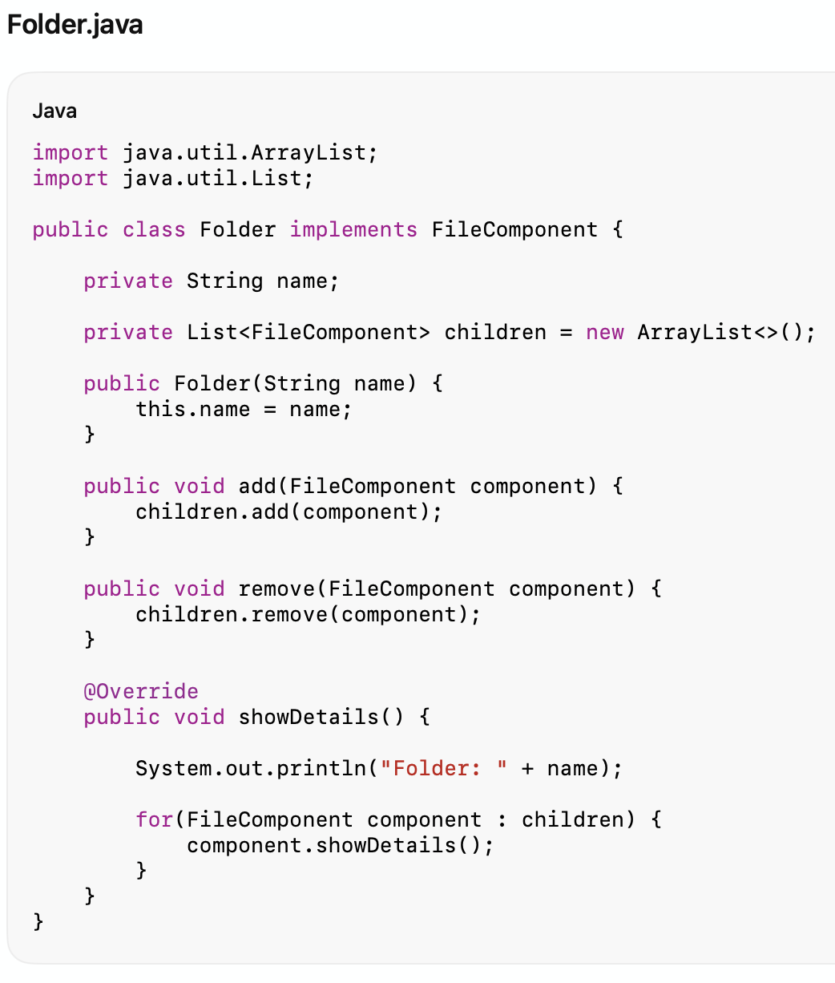
Java Code

Slide 26
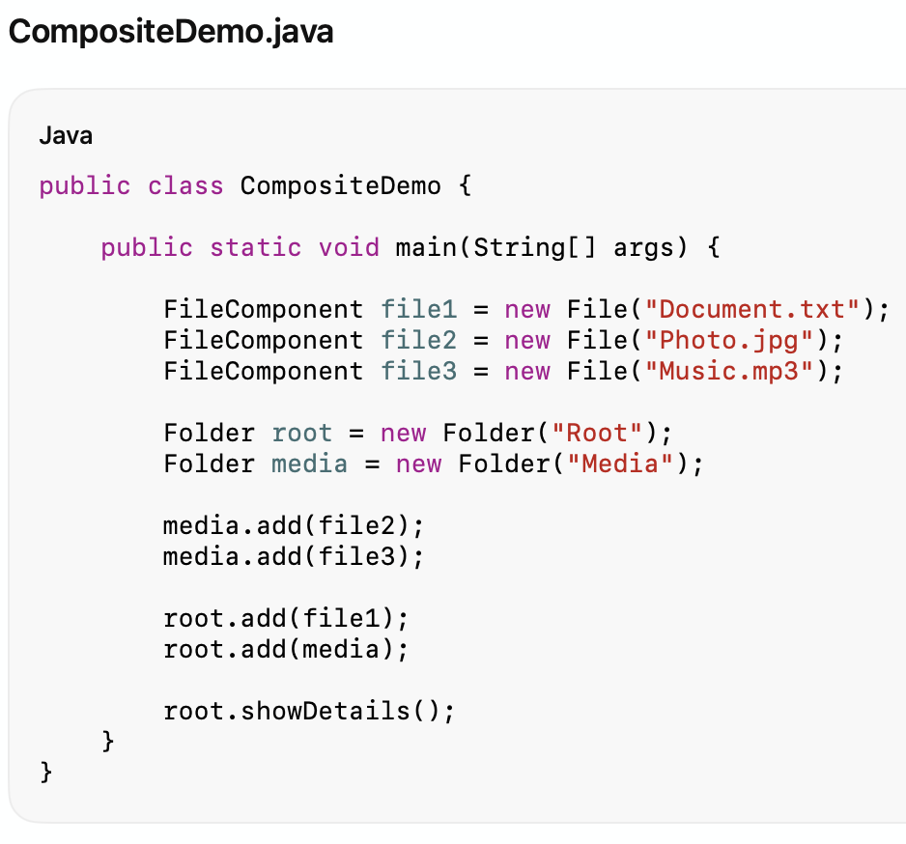
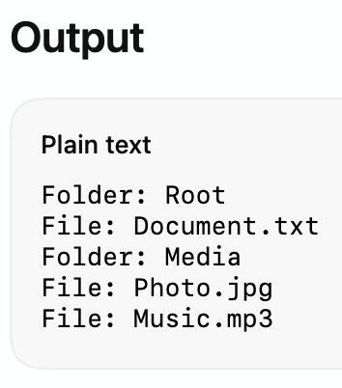
Java Code

Slide 27
Advantages & Disadvantages
Advantages of Composite Pattern
Simplifies tree structures.
Treats leaves and composites uniformly.
Supports recursive composition.
Simplifies client code.
Easy to add new component types.
Disadvantages
Can make design overly general.
Harder to restrict valid child types.
Recursive structures may become complex.

Slide 28
When to Use Composite Pattern
You have tree-like structures.
Individual and grouped objects should be treated uniformly.
Recursive object composition is needed.
Hierarchical operations are common.

Slide 29
